Slide 1
HRNet: Deep High-Resolution Representation Learning for Visual Recognition
Jingdong Wang

Slide 2
HRNet: Deep high-resolution representation learning
Most computer vision problems, such as human pose estimation, and object detection, are position-sensitive and need high-resolution representations.
Current SOTA solutions are developed by extending, remediating and repairing representations for low-resolution networks (e.g., ResNet, and VGGNet, which follow the design of LeNet-5, Yann LeCun 1998). Typical works include U-Net, Hourglass, and encoder-decoder.
We make fundamental architecture changes:
Connect high-to-low resolution convolutions in parallel instead of in series done in ResNet and VGGNets
Maintain high-resolution representations through the whole process instead of recovering from low-resolution representations
Repeat fusions across resolutions to strengthen the representations
Our HRNet achieves SOTA results on human pose estimation, semantic segmentation, as well as object detection. The HRNet has been adopted/studied by others (such as Face++, SenseTime, Google, Facebook) for a wide range of problems, including image reconstruction (Meitu), image dehazing (Meitu), super-resolution, medical image segmentation, human/car detection for autonomous driving (TuSimple). AzureCAT is adopting HRNet for satellite and seismic image segmentation

Slide 3
Neural architecture design
deeper
→ wider
→ finer
Deeper - more layers
Wider - more channels
Finer -
higher resolution
New dimension: go finer towards high-resolution representation learning
Notes:
Since 2012, there are two main design patterns for boost the capacity: one is going deeper. Add more and more convolutional layers. For example, alexnet layers,…..resnets 152 layers.
The other one is going wider: add more channels in the convolution, typical methods include group convolution or parallel convolutions.
In this talk, I will investigate another dimension: go finer. It means to increase the spatial size of the representations.

Slide 4
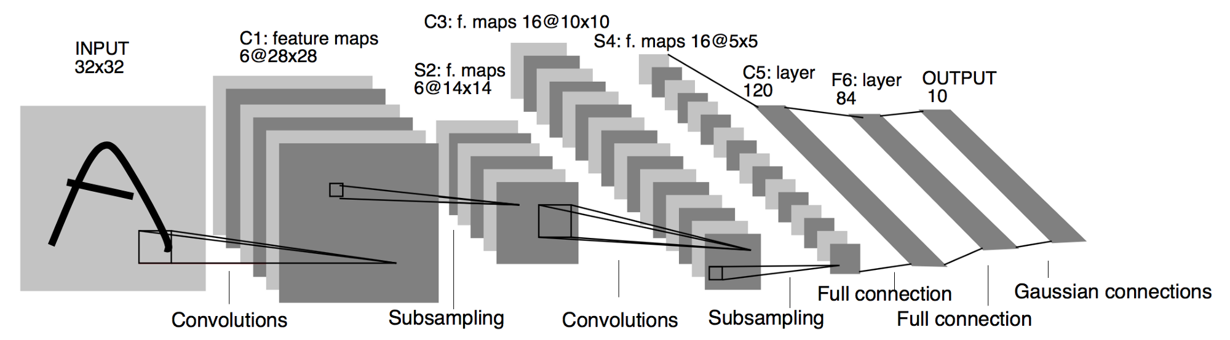
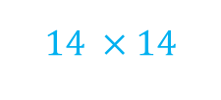


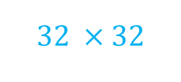

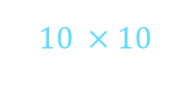
Low-resolution representation learning
Connect multi-resolution convolutions in series
High-resolution conv. → medium-resolution conv. → low-resolution conv.
$$28 ×28$$
$$10 ×10$$
$$1/6$$
$$32 ×32$$
$$14 ×14$$
$$5×5$$
LeNet-5, 1998
and other classification networks: AlexNet, VGGNet, GoogleNet, ResNet, DenseNet, ……
Notes:
Here is a typical structure, LeNet-5. The convolutions are first performed on high-resolution, 32 * 32, then the size of representation is reduced to 14 * 14 (padding), where the medium-resolution convolutions are conducted. Next, the size is reduced to 5 * 5, and small-resolution convolutions are done. Finally the low-resolution representations, here, 5 * 5 representation map, are aggregated into a vector for classification.
Actually this kind of design pattern is followed by recently-developed popular architectures, such as AlexNet..All of them gradually reduce the spatial sizes of the represetnations, and convolutions are performed on smaller and smaller representation maps.

Slide 5
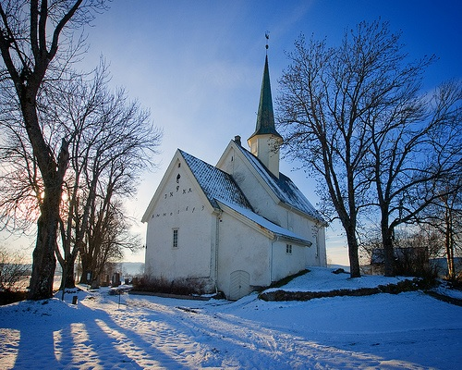
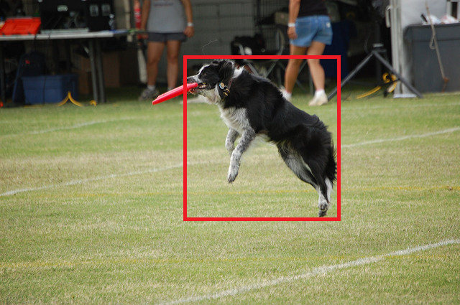
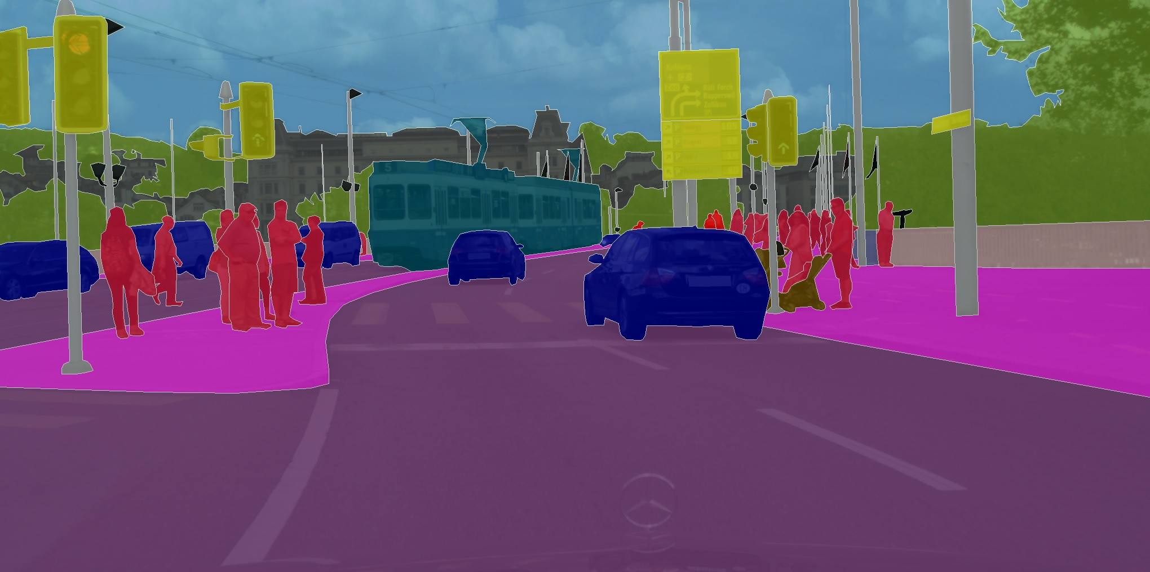
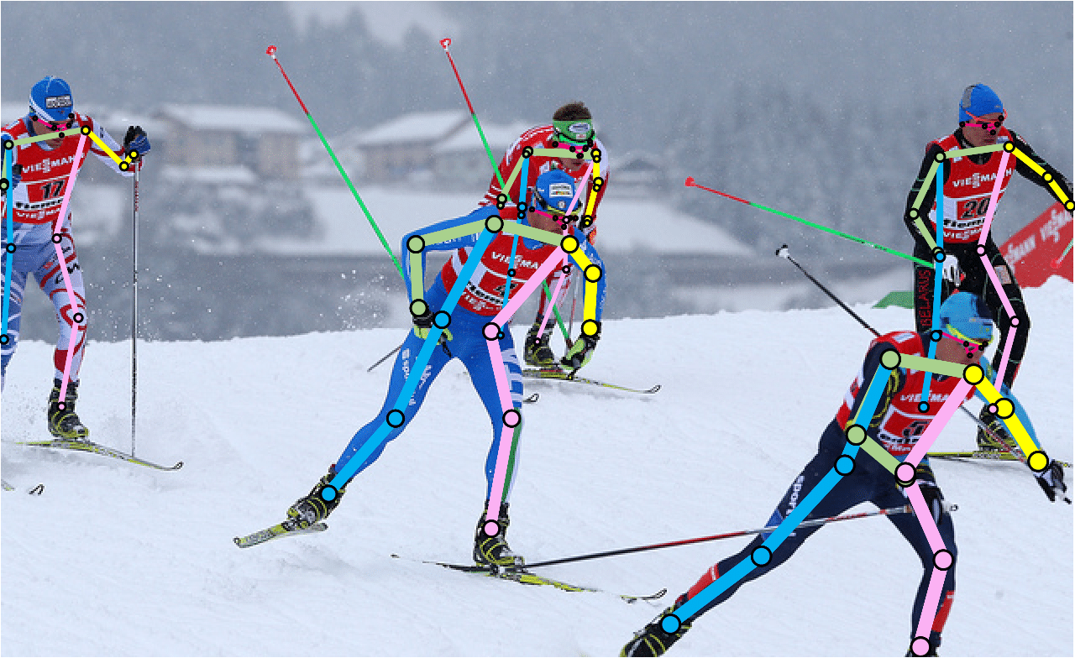
Low resolution is enough
The high-resolution representation is needed
……
image recog.
region-level recog.
pixel-level recog.
global
position-sensitive
Notes:
The low-resolution representation might be enough for image classification. But for position-sensitive problems, for example,
object detection, we need to the position of the bounding box of the object.
Semantic segmentation, we need to predict the label for each pixel
Face alignment/human pose estimation, the state-of-the-art solutions estimate dense heatmaps, where each pixel is assigned to a confidence vector showing the degree that it belongs to face landmark/human key point.
These problems require high-resolution representations.

Slide 6
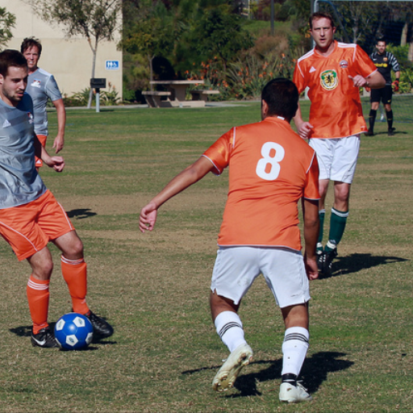
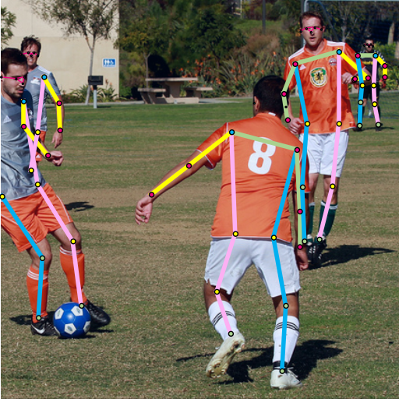
Human pose estimation
Notes:
We know that in computer vision, CNN has been the dominant solutions for many problems, for example, classification. One major benefit of CNN is that it can automatically learn rich representations. Such representations perform much better than previous hand-crafted representations.
And many research efforts have been done for designing the CNN architectures.

Slide 7
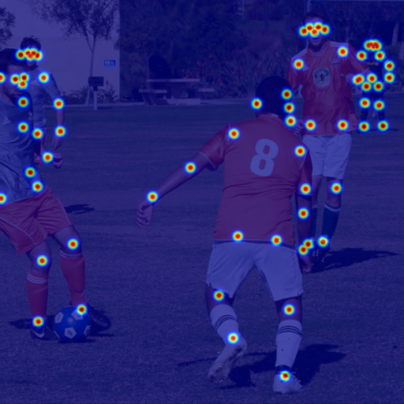
Human pose estimation
Notes:
We know that in computer vision, CNN has been the dominant solutions for many problems, for example, classification. One major benefit of CNN is that it can automatically learn rich representations. Such representations perform much better than previous hand-crafted representations.
And many research efforts have been done for designing the CNN architectures.

Slide 8
High-resolution representation learning
Previous solutions
Based on low-resolution representations from classification networks
Recover high resolution from low resolution
Hourglass, U-Net, Encoder-decoder, DeconvNet, SimpleBaseline, etc
Notes:
(Hourglass, U-Net, Encoder-decoder, DeconNet, SimpleBaseline):

Slide 9

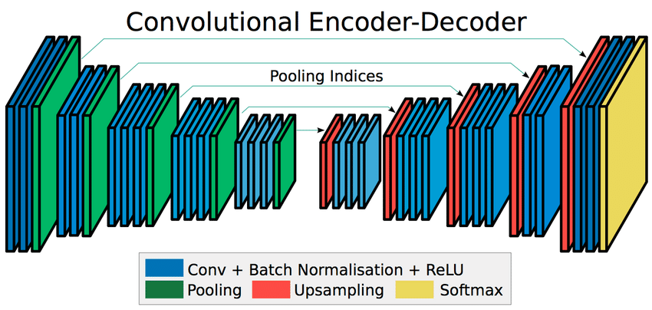
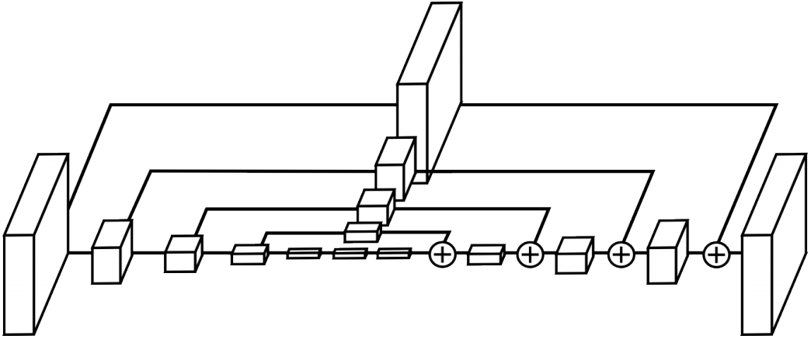
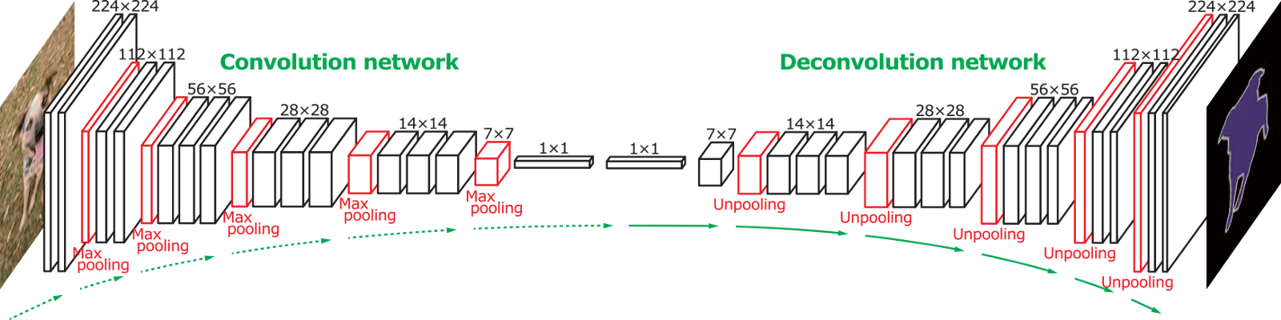
SegNet
U-Net
DeconvNet
Hourglass
Look different, essentially the same

Slide 10
High-resolution representation learning
Previous solutions
Based on low-resolution representations from classification networks
Recover high resolution from low resolution
Drawback: representations are weak due to location-sensitivity loss
Hourglass, U-Net, Encoder-decoder, DeconvNet, SimpleBaseline, etc
Notes:
(Hourglass, U-Net, Encoder-decoder, DeconNet, SimpleBaseline):

Slide 11
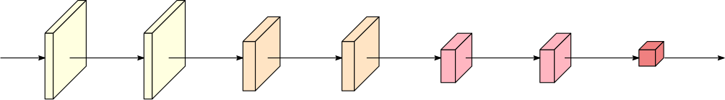
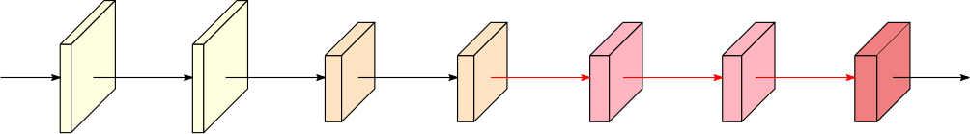
High-resolution representation learning
remove down-sampling
resolution is medium, computation is costly

Slide 12
Our work: High-resolution networks (HRNet)
Learn high-resolution representations through high resolution maintenance rather than recovering
Ke Sun, Bin Xiao, Dong Liu, Jingdong Wang: Deep High-Resolution Representation Learning for Human Pose Estimation. CVPR 2019

Slide 13
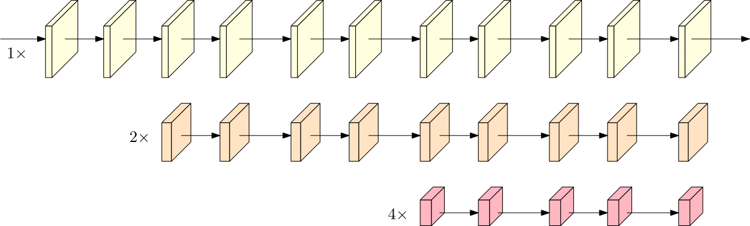
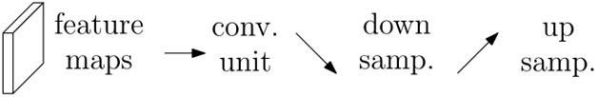
Previous classification networks
Connect multi-resolution convolutions in series
Notes:
As mentioned before, the previous networks mainly connect the convolutions sequentially, from high-resolution to low-resolution.

Slide 14
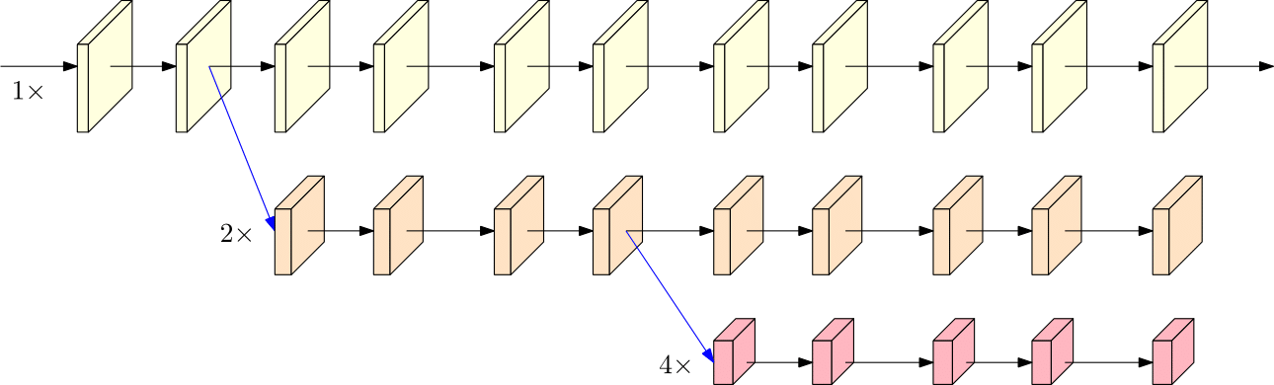
HRNet: high-resolution representation learning
High-resolution networks (HRNet): Connect multi-resolution convolutions in parallel with repeated fusions
Notes:
Differently, our HRNet connects the multi-resolution convolutions in parallel. Here is an example with three resolutions. It consists of three streams: each stream corresponds to

Slide 15
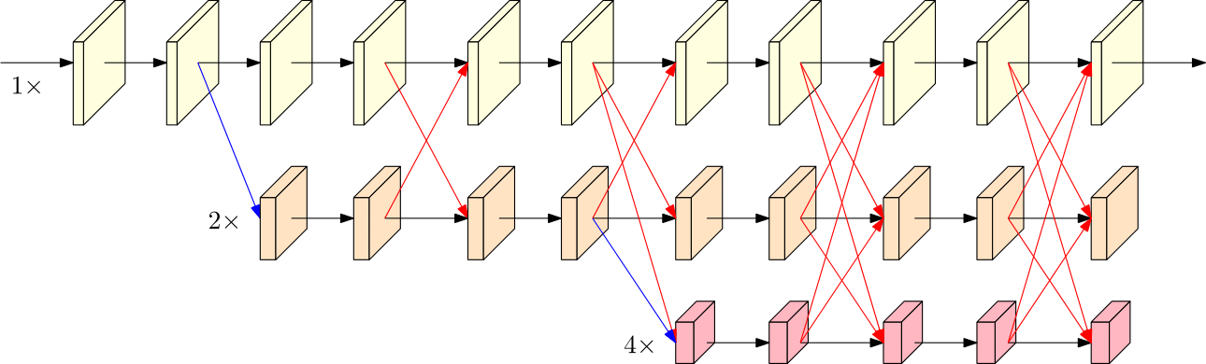
HRNet: high-resolution representation learning
High-resolution networks (HRNet): Connect multi-resolution convolutions in parallel with repeated fusions
Notes:
Besides, there consists of repeated information exchange between the parallel streams.
The reason is that high-resolution representation has location-sensitivity, but low semantics, low-resolution has high semantics,

Slide 16
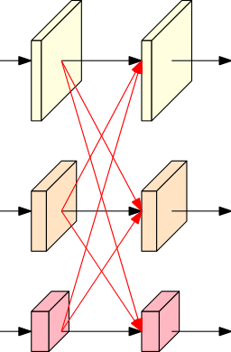
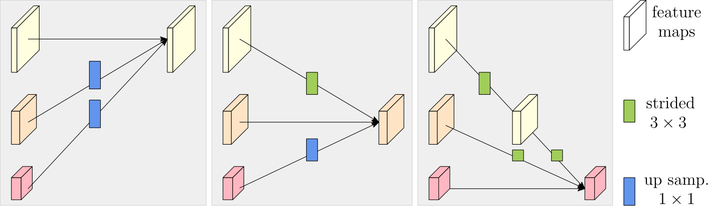

Across-resolution fusion
Down-sample: $stride−2$ $3×3$
Up-sample: $bilinear$ + $1×1$

Slide 17
Fundamental architecture changes
parallel
Connect high-to-low resolution convolutions in series
Recover high-resolution representations from low-resolution representations
Repeat fusions across resolutions to strengthen high- & low-resolution representations
Maintain
through the whole process
HRNet can learn high-resolution strong representations
Notes:
through the whole process

Slide 18
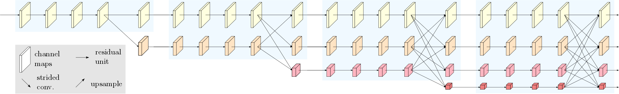
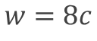
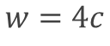
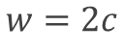
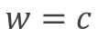
HRNet instantiation
$$w=c$$
$$w=2c$$
$$w=4c$$
$$w=8c$$
#blocks = 1
#blocks = 4
#blocks = 3
Notes:
This shows the structure that we use in our experiments. There are four stages.
The first stage consists of high-resolution convolutions.
The second stage consists of one multi-resolution blocks.
Before this HRNet, we have a stem that is similar to ResNet.
As a result, the total depth is fixed as 75 conv. Layers.
And, we change the width of each stream to change the capacity.

Slide 19
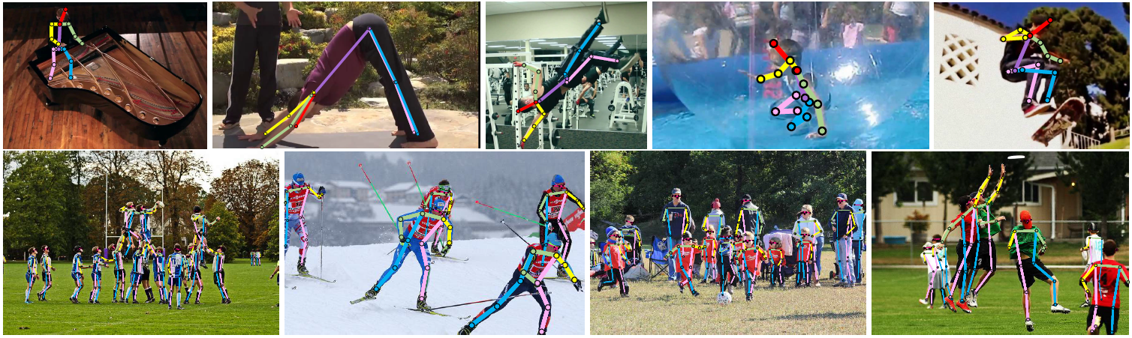
Human pose estimation

Slide 20
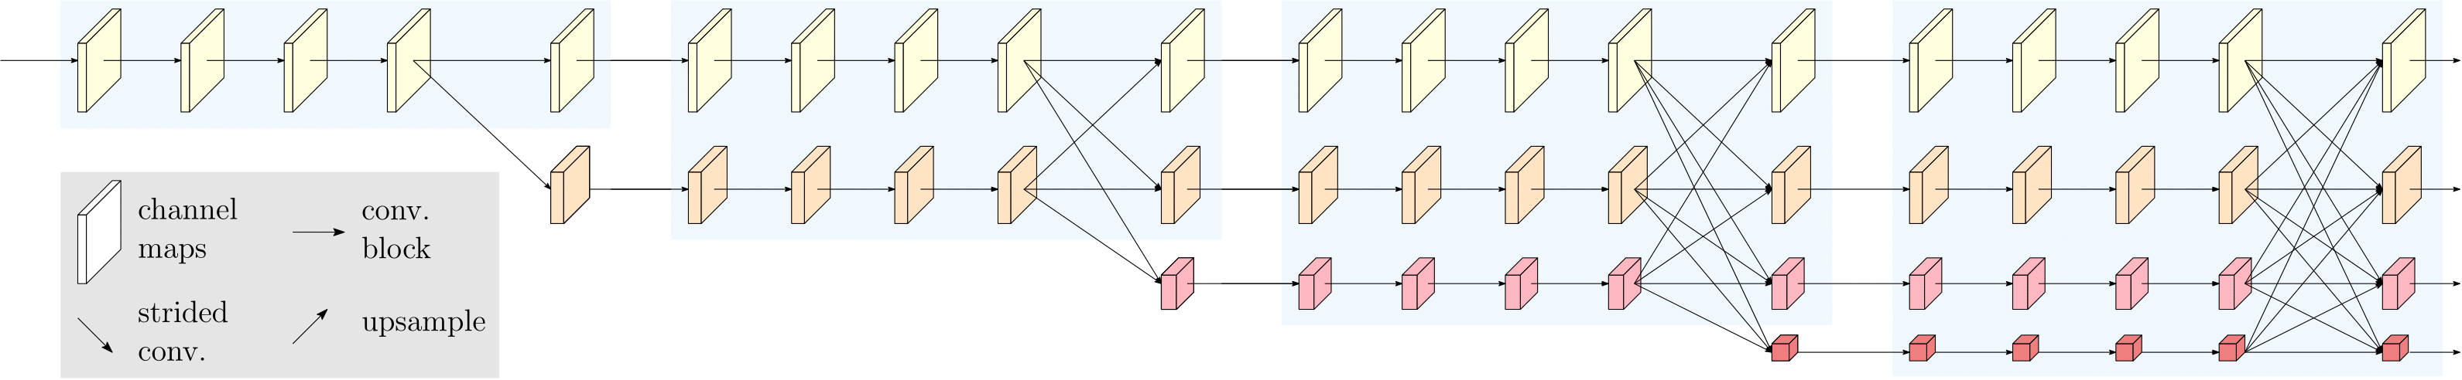
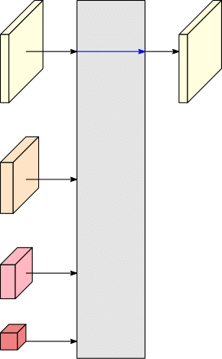
HRNetV1

Slide 21
Datasets and evaluation
Datasets | training | validation | testing | Evaluation
COCO 2017 | 57K | 5000 images | 20K | AP@OKS
PoseTrack | 292 videos | 50 | 208 | mAP/MOTA
COCO: http://cocodataset.org/#keypoints-eval
PoseTrack https://posetrack.net/
Notes:
standard evaluation metric is based on Object Keypoint Similarity (OKS)
PCKh: head-normalized probability of correct keypoint
MPII http://human-pose.mpi-inf.mpg.de/

Slide 22
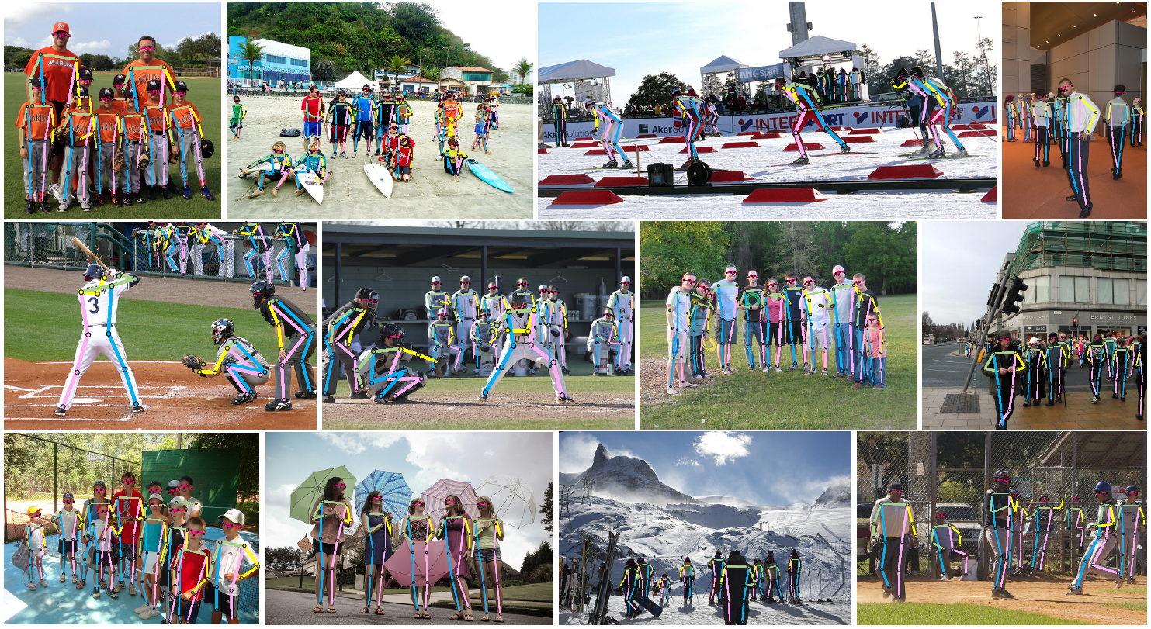
COCO

Slide 23
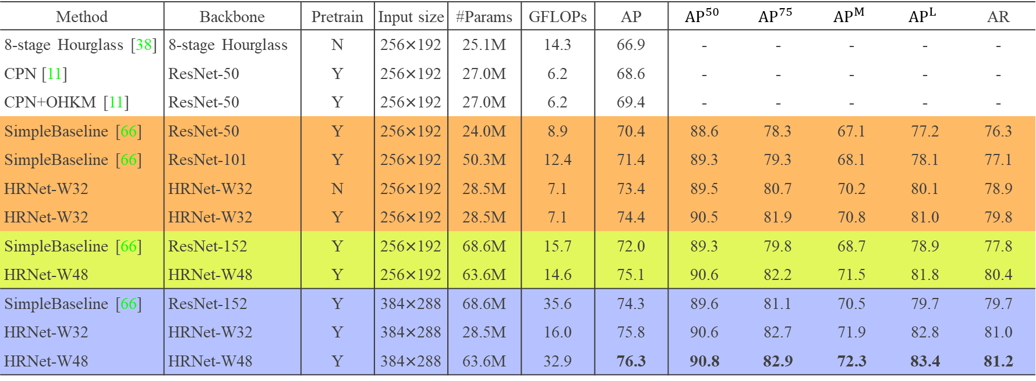
COCO validation
Method | Backbone | Pretrain | Input size | #Params | GFLOPs | AP | $${AP}^{50}$$ | $${AP}^{75}$$ | $${AP}^{M}$$ | $${AP}^{L}$$ | AR
8-stage Hourglass [38] | 8-stage Hourglass | N | 256×192 | 25.1M | 14.3 | 66.9 | - | - | - | - | -
CPN [11] | ResNet-50 | Y | 256×192 | 27.0M | 6.2 | 68.6 | - | - | - | - | -
CPN+OHKM [11] | ResNet-50 | Y | 256×192 | 27.0M | 6.2 | 69.4 | - | - | - | - | -
SimpleBaseline [66] | ResNet-50 | Y | 256×192 | 24.0M | 8.9 | 70.4 | 88.6 | 78.3 | 67.1 | 77.2 | 76.3
SimpleBaseline [66] | ResNet-101 | Y | 256×192 | 50.3M | 12.4 | 71.4 | 89.3 | 79.3 | 68.1 | 78.1 | 77.1
HRNet-W32 | HRNet-W32 | N | 256×192 | 28.5M | 7.1 | 73.4 | 89.5 | 80.7 | 70.2 | 80.1 | 78.9
HRNet-W32 | HRNet-W32 | Y | 256×192 | 28.5M | 7.1 | 74.4 | 90.5 | 81.9 | 70.8 | 81.0 | 79.8
SimpleBaseline [66] | ResNet-152 | Y | 256×192 | 68.6M | 15.7 | 72.0 | 89.3 | 79.8 | 68.7 | 78.9 | 77.8
HRNet-W48 | HRNet-W48 | Y | 256×192 | 63.6M | 14.6 | 75.1 | 90.6 | 82.2 | 71.5 | 81.8 | 80.4
SimpleBaseline [66] | ResNet-152 | Y | 384×288 | 68.6M | 35.6 | 74.3 | 89.6 | 81.1 | 70.5 | 79.7 | 79.7
HRNet-W32 | HRNet-W32 | Y | 384×288 | 28.5M | 16.0 | 75.8 | 90.6 | 82.7 | 71.9 | 82.8 | 81.0
HRNet-W48 | HRNet-W48 | Y | 384×288 | 63.6M | 32.9 | 76.3 | 90.8 | 82.9 | 72.3 | 83.4 | 81.2
Notes:
Table 1: Comparisons on the COCO validation set. Pretrain = pretrain the backbone on the ImageNet classification task. OHKM = online hard keypoints mining [11]

Slide 24
COCO test-dev
method | Backbone | Input size | #Params | GFLOPs | AP | AP⁵⁰ | AP⁷⁵ | AP^{M} | AP^{L} | AR
Bottom-up: keypoint detection and grouping
OpenPose [6], CMU | - | - | - | - | 61.8 | 84.9 | 67.5 | 57.1 | 68.2 | 66.5
Associative Embedding [39] | - | - | - | - | 65.5 | 86.8 | 72.3 | 60.6 | 72.6 | 70.2
PersonLab [46], Google | - | - | - | - | 68.7 | 89.0 | 75.4 | 64.1 | 75.5 | 75.4
MultiPoseNet [33] | - | - | - | - | 69.6 | 86.3 | 76.6 | 65.0 | 76.3 | 73.5
Top-down: human detection and single-person keypoint detection
Mask-RCNN [21], Facebook | ResNet-50-FPN | - | - | - | 63.1 | 87.3 | 68.7 | 57.8 | 71.4 | -
G-RMI [47] | ResNet-101 | 353×257 | 42.0M | 57.0 | 64.9 | 85.5 | 71.3 | 62.3 | 70.0 | 69.7
Integral Pose Regression [60] | ResNet-101 | 256×256 | 45.0M | 11.0 | 67.8 | 88.2 | 74.8 | 63.9 | 74.0 | -
G-RMI + extra data [47] | ResNet-101 | 353×257 | 42.6M | 57.0 | 68.5 | 87.1 | 75.5 | 65.8 | 73.3 | 73.3
CPN [11] , Face++ | ResNet-Inception | 384×288 | - | - | 72.1 | 91.4 | 80.0 | 68.7 | 77.2 | 78.5
RMPE [17] | PyraNet [77] | 320×256 | 28.1M | 26.7 | 72.3 | 89.2 | 79.1 | 68.0 | 78.6 | -
CFN [25] , | - | - | - | - | 72.6 | 86.1 | 69.7 | 78.3 | 64.1 | -
CPN (ensemble) [11], Face++ | ResNet-Inception | 384×288 | - | - | 73.0 | 91.7 | 80.9 | 69.5 | 78.1 | 79.0
SimpleBaseline [72], Microsoft | ResNet-152 | 384×288 | 68.6M | 35.6 | 73.7 | 91.9 | 81.1 | 70.3 | 80.0 | 79.0
HRNet-W32 | HRNet-W32 | 384×288 | 28.5M | 16.0 | 74.9 | 92.5 | 82.8 | 71.3 | 80.9 | 80.1
HRNet-W48 | HRNet-W48 | 384×288 | 63.6M | 32.9 | 75.5 | 92.5 | 83.3 | 71.9 | 81.5 | 80.5
HRNet-W48 + extra data | HRNet-W48 | 384×288 | 63.6M | 32.9 | 77.0 | 92.7 | 84.5 | 73.4 | 83.1 | 82.0
Notes:
Table 2 Comparisons on the COCO test-dev set. #Params and FLOPs are calculated for the pose estimation network, and those for human detection and keypoint grouping are not included.

Slide 25
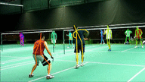
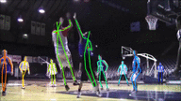
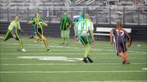
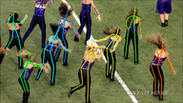
PoseTrack2017: multi-person pose estimation & tracking

Slide 26
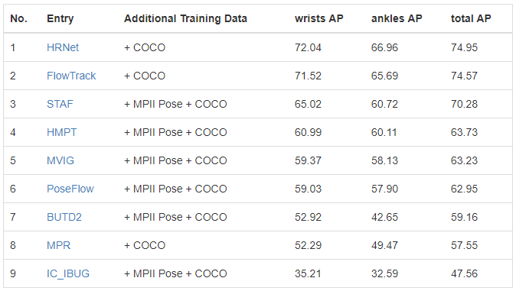
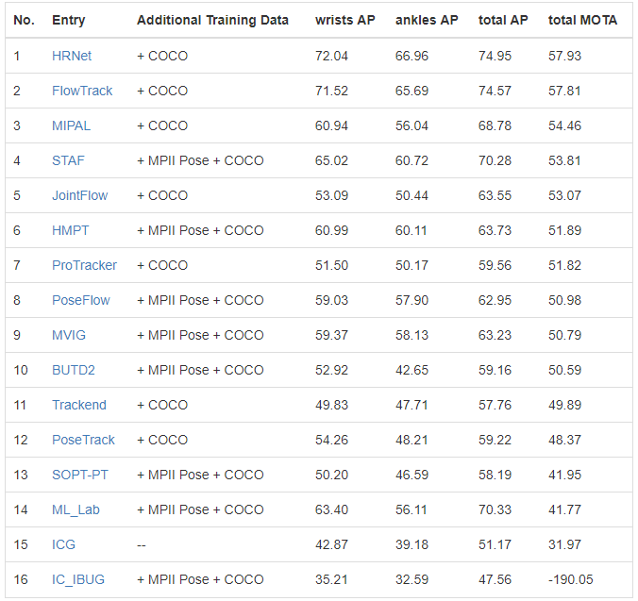
PoseTrack Leaderboard
Multi-Frame Person Pose Estimation
Multi-Person Pose Tracking
https://posetrack.net/leaderboard.php
by Feb. 28, 2019

Slide 27
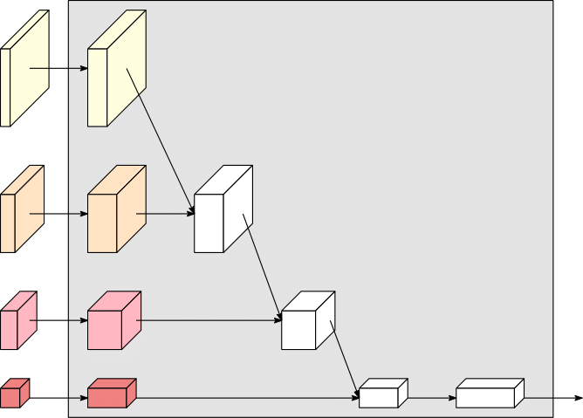
HRNets for ImageNet classification

Slide 28
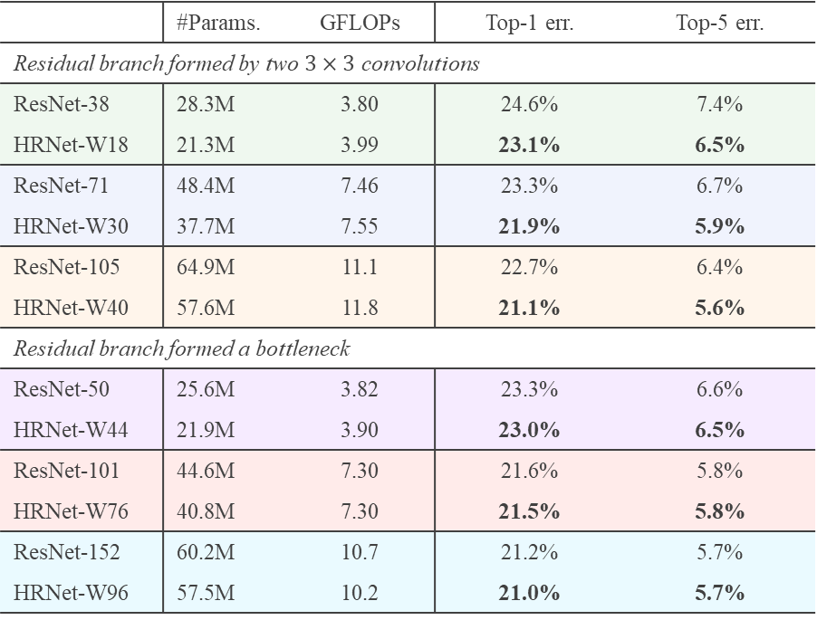
ImageNet classification
 | #Params. | GFLOPs | Top-1 err. | Top-5 err.
Residual branch formed by two $3×3$ convolutions
ResNet-38 | 28.3M | 3.80 | 24.6% | 7.4%
HRNet-W18 | 21.3M | 3.99 | 23.1% | 6.5%
ResNet-71 | 48.4M | 7.46 | 23.3% | 6.7%
HRNet-W30 | 37.7M | 7.55 | 21.9% | 5.9%
ResNet-105 | 64.9M | 11.1 | 22.7% | 6.4%
HRNet-W40 | 57.6M | 11.8 | 21.1% | 5.6%
Residual branch formed a bottleneck
ResNet-50 | 25.6M | 3.82 | 23.3% | 6.6%
HRNet-W44 | 21.9M | 3.90 | 23.0% | 6.5%
ResNet-101 | 44.6M | 7.30 | 21.6% | 5.8%
HRNet-W76 | 40.8M | 7.30 | 21.5% | 5.8%
ResNet-152 | 60.2M | 10.7 | 21.2% | 5.7%
HRNet-W96 | 57.5M | 10.2 | 21.0% | 5.7%
Surprisingly, HRNet performs slightly better than ResNet
Notes:
Table 1: ImageNet classification results of our HRNet and
ResNets

Slide 29
vs. variants
 | #Params. | GFLOPs | Top-1 err. | Top-5 err.
HRNet-W27-Ci | 21.4M | 5.55 | 26.0% | 7.7%
HRNet-W25-Cii | 21.7M | 5.04 | 24.1% | 7.1%
HRNet-W18-C | 21.3M | 3.99 | 23.1% | 6.5%
HRNet-W36-Ci | 37.5M | 9.00 | 24.3% | 7.3%
HRNet-W34-Cii | 36.7M | 8.29 | 22.8% | 6.3%
HRNet-W30-C | 37.7M | 7.55 | 21.9% | 5.9%
HRNet-W45-Ci | 58.2M | 13.4 | 23.6% | 7.0%
HRNet-W43-Cii | 56.3M | 12.5 | 22.2% | 6.1%
HRNet-W40-C | 57.6M | 11.8 | 21.1% | 5.6%
Notes:
Table 2: Ablation study on ImageNet classification by comparing
our approach (abbreated by HRNet-Wx-C) to two alternatives:
HRNet-Wx-Ci and HRNet-Wx-Cii.

Slide 30
Visual recognition applications
Image classification
Object detection
Semantic segmentation
Pose estimation

Slide 31


High-resolution networks vs classification networks
image-level
region-level
pixel-level
Low resolution
High resolution
Recover from low-resolution (ResNet, VGGNet) ✗
High-resolution (our HRNet) ✓

Slide 32
Visual recognition applications
and …
Image classification
Object detection
Semantic segmentation
Pose estimation

Slide 33
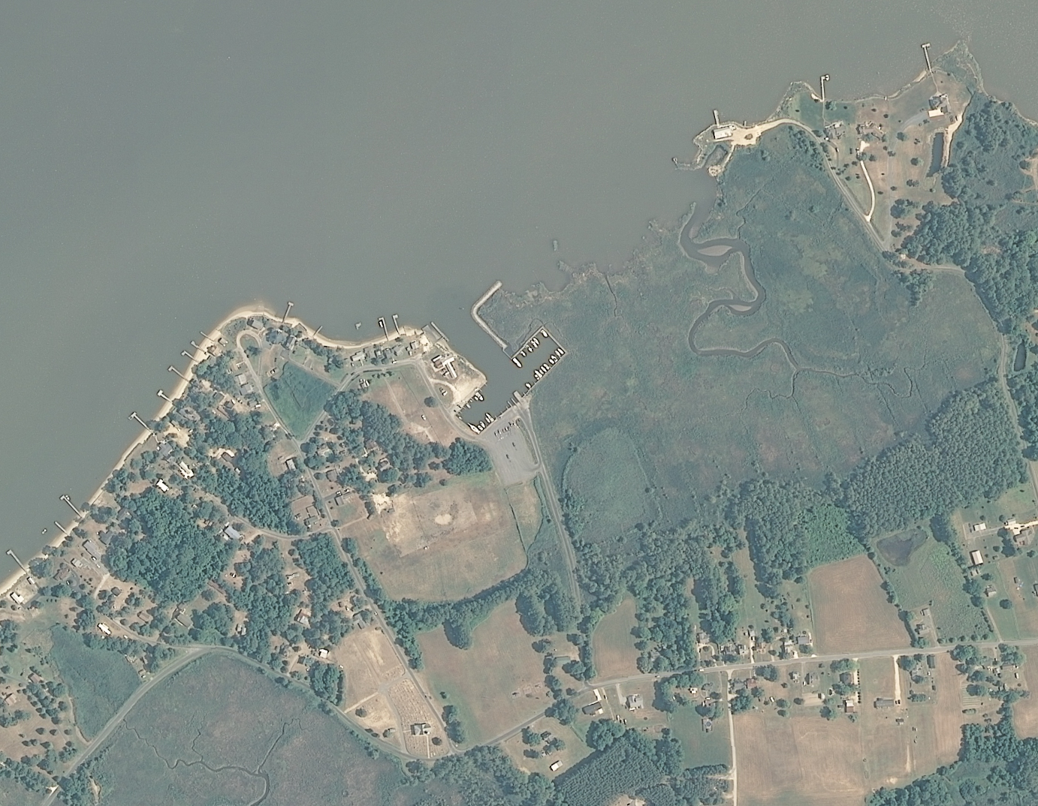
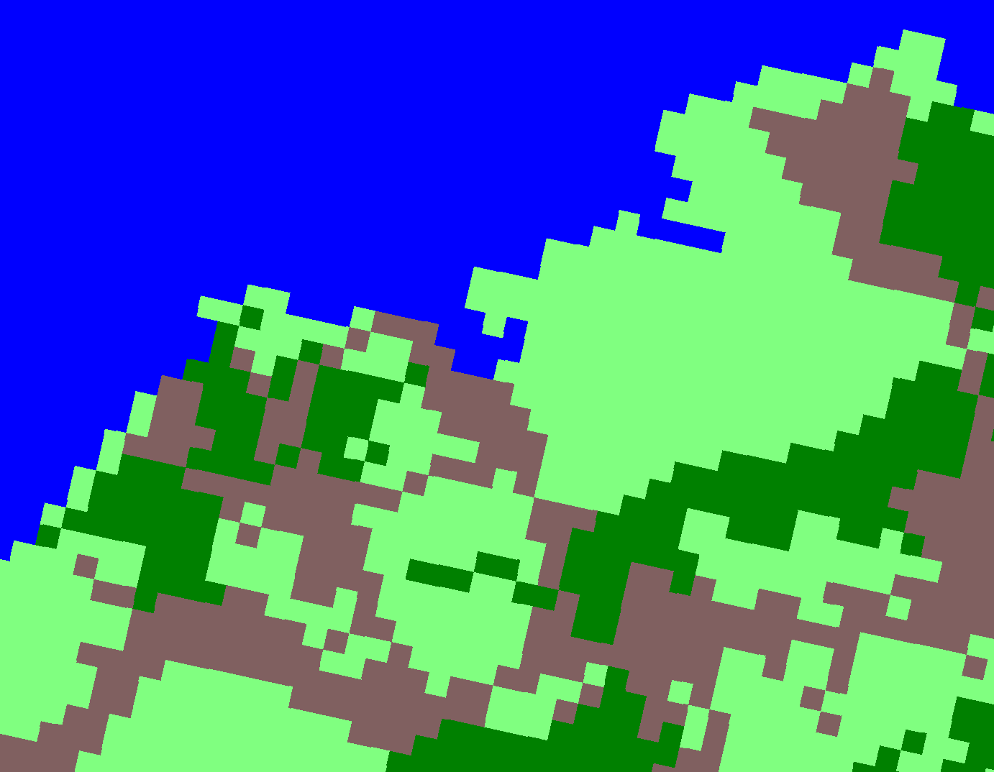
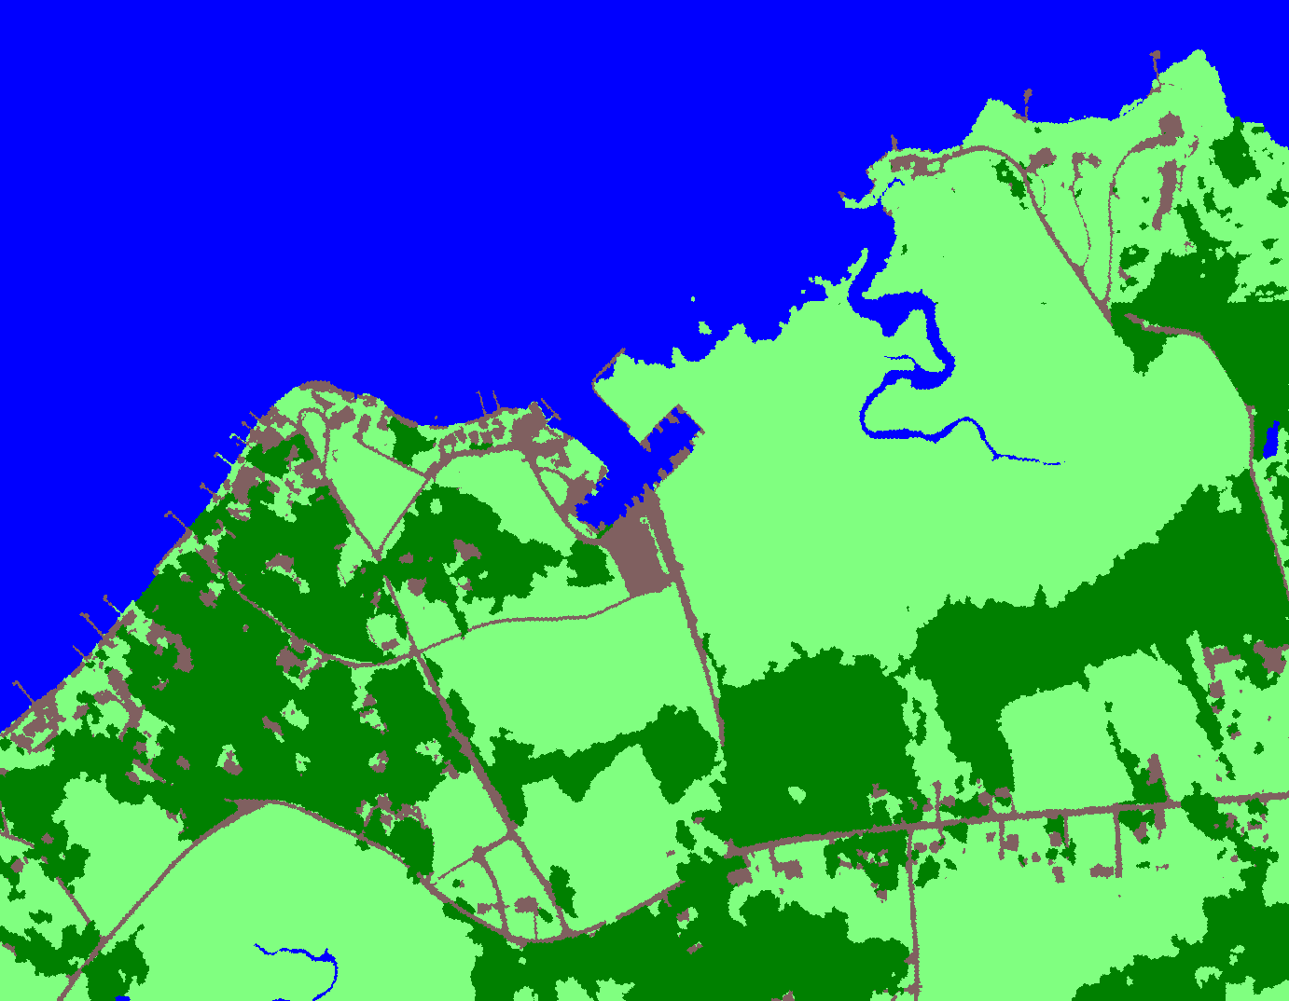
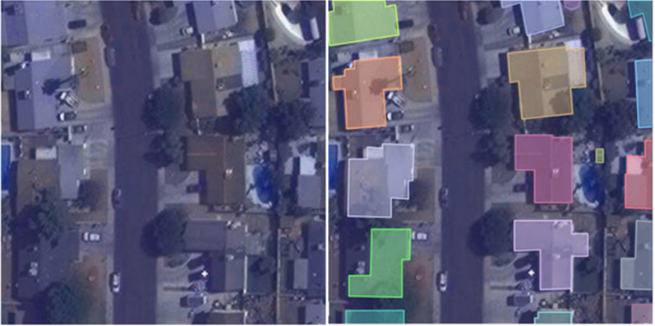
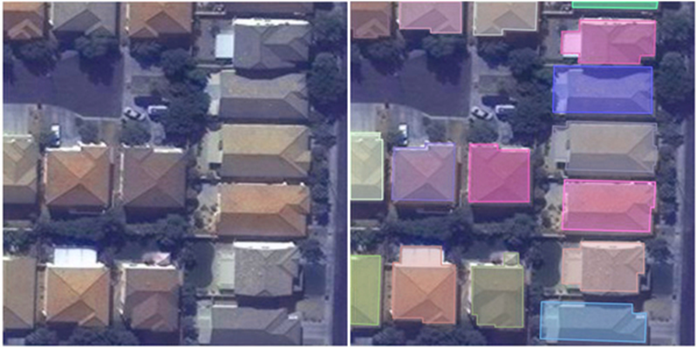
Satellite image segmentation (AzureCAT)
The AzureCAT team adopted HRNet for satellite and seismic image parsing
Notes:
satellite image
seismic image
human actitivity
xView: multi-object multi-scale
SpaceNet
Wee Hyong Tok: manager of London office. buidling detection
Azure CAT: customer advisory team

Slide 34



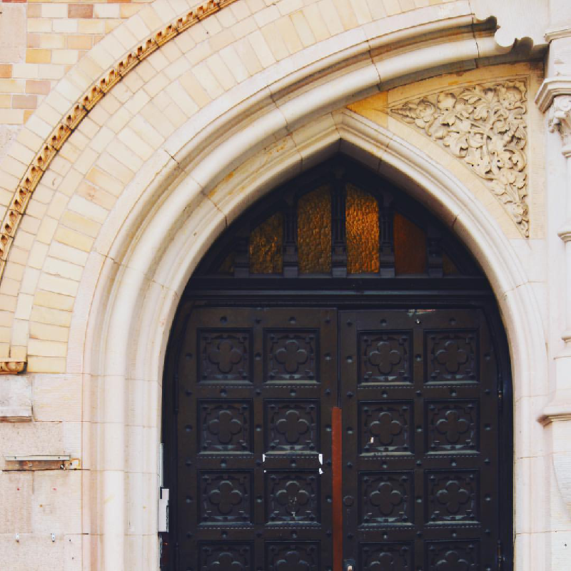
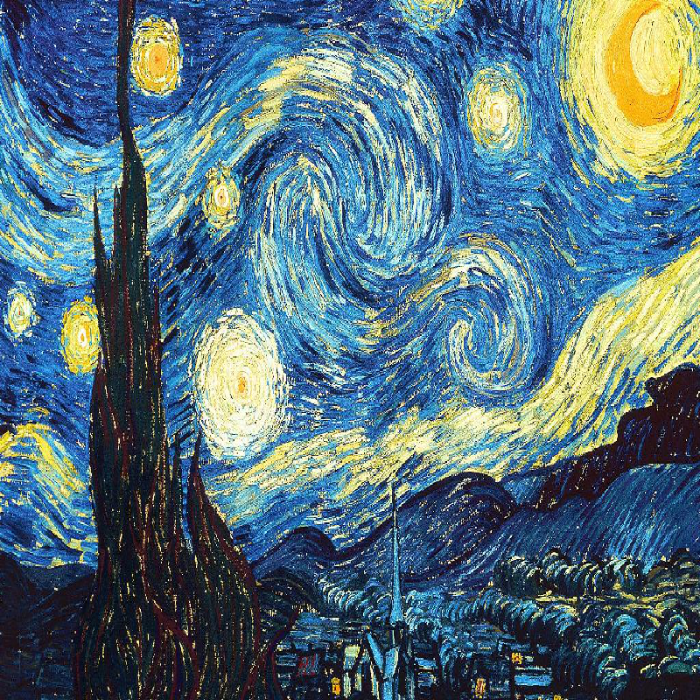
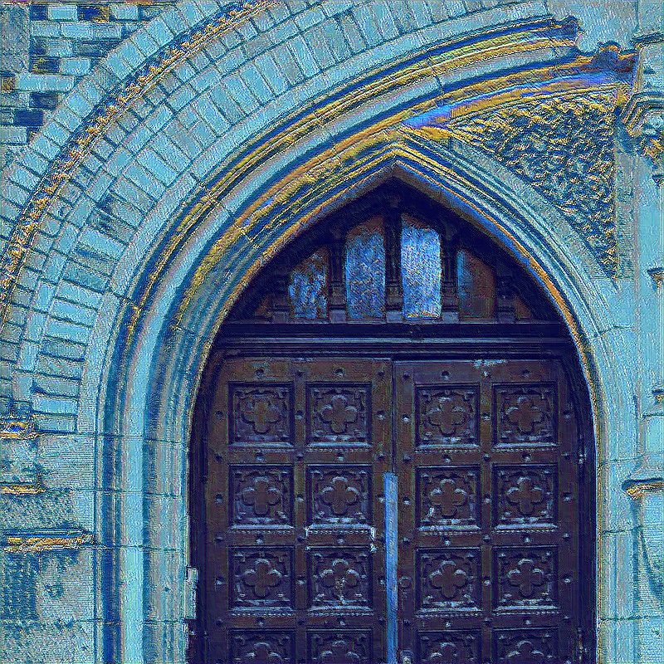
Photo style transfer
Ming Li, Chunyang Ye, Wei Li: High-Resolution Network for Photorealistic Style Transfer. CoRR abs/1904.11617 (2019)
Notes:
Ming Li, Chunyang Ye, Wei Li: High-Resolution Network for Photorealistic Style Transfer. CoRR abs/1904.11617 (2019)

Slide 35
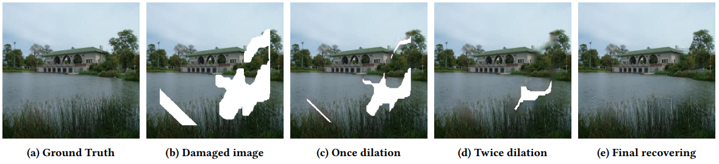
Image inpainting
Progressive Image Inpainting with Full-Resolution Residual Network. Zongyu Guo, Zhibo Chen, Tao Yu, Jiale Chen, Sen Liu. ACM MM 2019

Slide 36
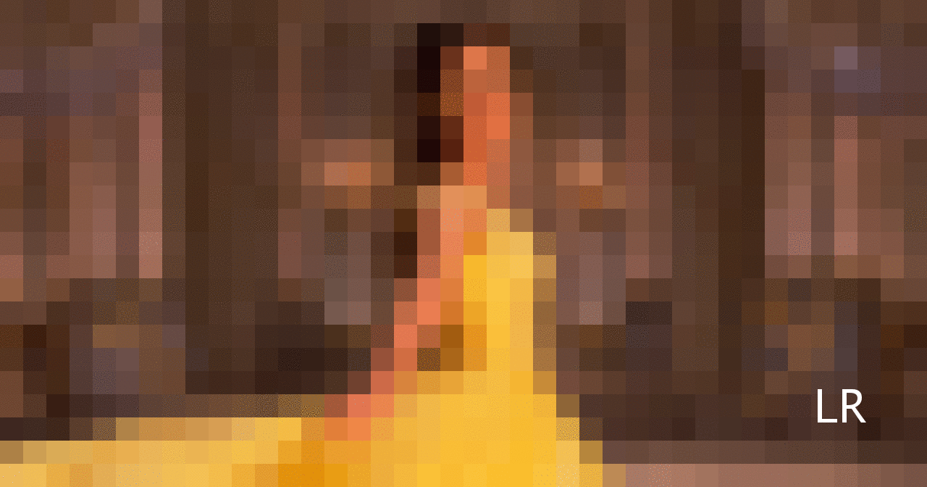



and …
Super-resolution from LapSRN
Optical flow
……
Depth estimation
Edge detection
Notes:
https://github.com/phoenix104104/LapSRN

Slide 37



Image enhancement challenge (CVPR 2019)
Meitu (美图) adopted the HRNet
NTIRE 2019 Challenge on Image Enhancement: Methods and Results. , CVPRW 2019
Notes:
NTIRE 2019 Challenge on Image Enhancement: Methods and Results

Slide 38


Slide 39






Slide 40

Cityscapes leaderboard: Rank 1

Slide 41
Summary
Method: Maintain high-resolution representations through the whole process with repeated across-resolution fusions
Result: State-of-the-art performance in position-sensitive vision tasks: semantic segmentation, object detection, human pose estimation
Role: Replace classification networks (e.g., ResNet) for computer vision tasks

Slide 42
Thanks!
Q&A

